Slide 1
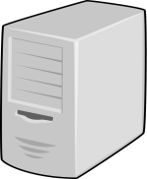
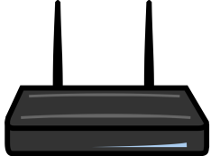
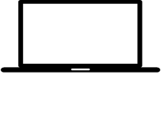

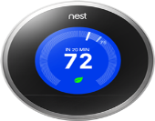
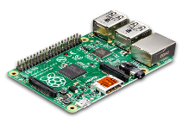

Cloud Layer
Gateway Layer
Decreasing resource constraint
Device Layer
Sensor Layer

Slide 2
s1
WasGeneratedBy
read
WasControlledBy
s2
WasGeneratedBy
File B

Slide 3
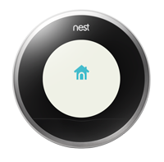
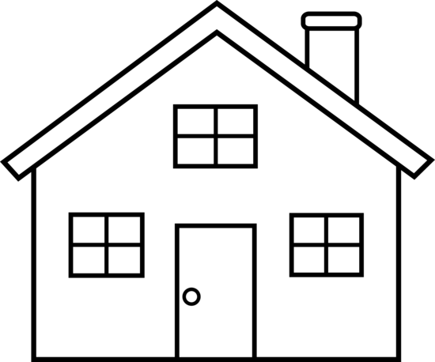


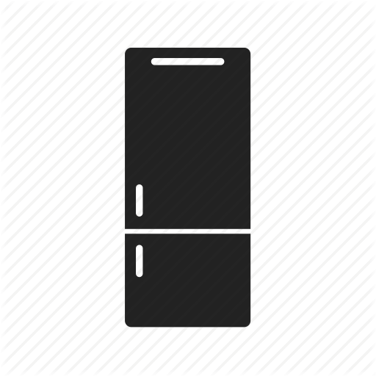



Thermostat
Light Bulb
Smoke Detector
Refrigerator
Camera
TV
Light Switch

Slide 4
Cloud layer
Gateway layer
Device layer
Sensor layer

